Slide 1
First Words:
A. Let us ______ because of the promise of God’s rest - Hebrews 4:1-10
1. The ___________ - Hebrews 4:1 – “Therefore…”
2. The ____________– Hebrews 4:1b – “…. while the promise of entering his rest still stands, let us fear lest any of you should seem to have failed to reach it.”
3. The ____________ – Hebrews 4:2-10
a. Because it is possible for us to respond in ___________ – Hebrews 4:2 - For good news came to us just as to them, but the message they heard did not benefit them, because they were not united by faith with those who listened.
b. Because it is possible for us to experience ___________ – Hebrews 4:3 - For we who have believed enter that rest, as he has said, “As I swore in my wrath, ‘They shall not enter my rest,’ ” although his works were finished from the foundation of the world.
c. Because it is possible for us to _____________ – Hebrews 4:4-7 - For he has somewhere spoken of the seventh day in this way: “And God rested on the seventh day from all his works.” ⁵ And again in this passage he said, “They shall not enter my rest.” ⁶ Since therefore it remains for some to enter it, and those who formerly received the good news failed to enter because of disobedience, ⁷ again he appoints a certain day, “Today,” saying through David so long afterward, in the words already quoted, “Today, if you hear his voice, do not harden your hearts.”
d. Because there remains a rest for ______________ – Hebrews 4:-8-9 - For if Joshua had given them rest, God would not have spoken of another day later on. ⁹ So then, there remains a Sabbath rest for the people of God,
e. Because those who entered His rest cease from ___________– Hebrews 4:10 - For whoever has entered God’s rest has also rested from his works as God did from his.

Slide 2
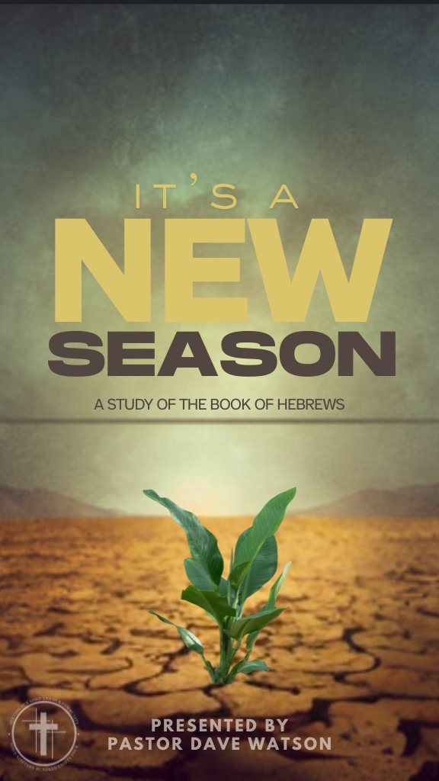
B. Let us _______ because of the promise of God’s rest- Hebrews 4:11-13
1. The ___________ - Hebrews 4:11b - “…therefore…”
2. The ___________ – Hebrews 4:11a&c – Let us strive to enter that rest, so that no one may fall by the same sort of disobedience.
3. The __________
a. Because we are ___________ by the Word of God – Hebrews 4:12 - For the word of God is living and active, sharper than any two-edged sword, piercing to the division of soul and of spirit, of joints and of marrow, and discerning the thoughts and intentions of the heart.
b. Because we are ____________ in the sight of God - Hebrews 4:13 - And no creature is hidden from his sight, but all are naked and exposed to the eyes of him to whom we must give account.
The Rest of God – Hebrews 4:1-13
So…What’s it to me?
Presented By: Pastor Dave Watson

