Slide 1
First Words
A. To be a follower of Atheism is to belong to a fast growing worldview
Atheism is more a World View than a religion.
There are 500 million Atheists world- wide.
There are two types of atheists, positive and negative. Positive Atheists say it is false to believe in deities, negative Atheists don’t believe in deities but don’t make such a declaration
In this same category are agnostics who say we can’t know for sure that there is a God or gods
In this same category are secularists who operate on a premise that there is no god/God
In many nations atheism is the dominant religion/world view. In China 91% of the population are atheists and in the United Kingdom 73% of the population are atheists.
The trend line in the United States is that atheism is growing (3 in 10 Americans identify as atheists, agnostics or nothing in particular).
B. To be a follower of Atheism is to be part of an old and diverse world view
1. In recent years there have been a more evangelistic group of Atheists seeking to convert others
2. Atheism is not new, it has been around for a long time. See the Psalmist in Psalm 14 and 53 – Psalm 14:1 “The fool says in his heart, “There is no God.”
3. Atheism is not a religion any more than not collecting stamps is a hobby
4. Atheists come in a variety of shapes and sizes
C. To be a follower of Atheism is to embrace the following beliefs/unbeliefs
2. Atheism is a rejection of the assertion that there is a god/gods
3. Atheism is a rejection of the assertion that supernatural events/things occur
4. Atheism is a rejection of the belief that outside of the cosmos there is anything
5. Atheism is a rejection of an immaterial nature of man. Everything about man is material.
6. Atheism is an assertion that all of life is simply a biological response.
7. Atheism is an assertion that morality has no other basis than in the universe and the highest evolved beings.
D. To be an atheist is to share the following components for ones worlview
1. Materialism – Matter exists eternally and is all that there is
2. Intellectualism – My reasoning and understanding are the measure of whether or not something is true
3. Humanism – Humans are the highest evolved being and the most complex machine
4. Behaviorism – Behavior is a matter of biology and chemicals and the modification of behavior is a matter of the same
5. Naturalism - Naturalism holds that everything that happens is simply a matter of the natural processes at work in the universe. Everything is cause and effect.
E. To be a follower of atheism is to embrace these beliefs
1. A denial of the existence of gods/God
2. A denial of the supernatural or miracles
3. A wholehearted acceptance of evolution

Slide 2
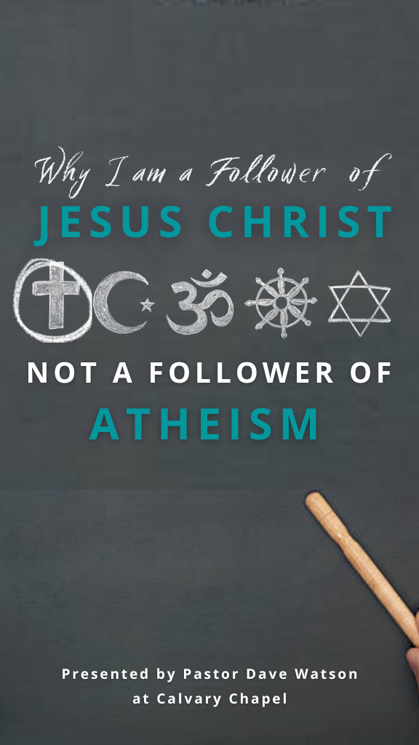
4. A belief on the potential of humanity
5. A belief in the primacy of science
6. A belief in everything being relative
7. A belief in the finality of death
F. To be a follower of Jesus Christ verses to be a follower of Atheism
1. Regarding one’s view of God
2. Regarding one’s view of the Bible and the writings of atheistic authors
3. Regarding one’s view of sin and salvation
4. Regarding one’s view of Jesus Christ
G. How should a follower of Jesus Christ view Atheism?
1. A foolish belief system – Psalm 14:1
2. A defeatable belief system – 2 Corinthians 10:3-5
3. An empty belief system – Ecclesiastes 1:2-4
Why I am a Follower of Jesus Christ and not of Atheism?
1. The need for a First Cause requires a belief in God – Genesis 1:1
2. The need for an Intelligent Designer of an orderly world requires a belief in God – Romans 1:19-20
3. The explanation of the longing of the human heart requires a belief in God – Ecclesiastes 3:11
4. The fact that I have a moral conscience requires a belief in God – Romans 2:14-16
5. The reality of the life, death and resurrection of Jesus Christ requires a belief in God – Acts 1:1-3

