Slide 1
First Words
At the Feet of Jesus, we experience:
The ________________for the Lord’s Work
Luke 19:28-34 - And when he had said these things, he went on ahead, going up to Jerusalem. ²⁹ When he drew near to Bethphage and Bethany, at the mount that is called Olivet, he sent two of the disciples, ³⁰ saying, “Go into the village in front of you, where on entering you will find a colt tied, on which no one has ever yet sat. Untie it and bring it here. ³¹ If anyone asks you, ‘Why are you untying it?’ you shall say this: ‘The Lord has need of it.’ ” ³² So those who were sent went away and found it just as he had told them. ³³ And as they were untying the colt, its owners said to them, “Why are you untying the colt?” ³⁴ And they said, “The Lord has need of it.”
The ________________of the Lord’s Kingdom
Luke 19:35-40 - And they brought it to Jesus, and throwing their cloaks on the colt, they set Jesus on it. ³⁶ And as he rode along, they spread their cloaks on the road. ³⁷ As he was drawing near—already on the way down the Mount of Olives—the whole multitude of his disciples began to rejoice and praise God with a loud voice for all the mighty works that they had seen, ³⁸ saying, “Blessed is the King who comes in the name of the Lord! Peace in heaven and glory in the highest!” ³⁹ And some of the Pharisees in the crowd said to him, “Teacher, rebuke your disciples.” ⁴⁰ He answered, “I tell you, if these were silent, the very stones would cry out.”

Slide 2
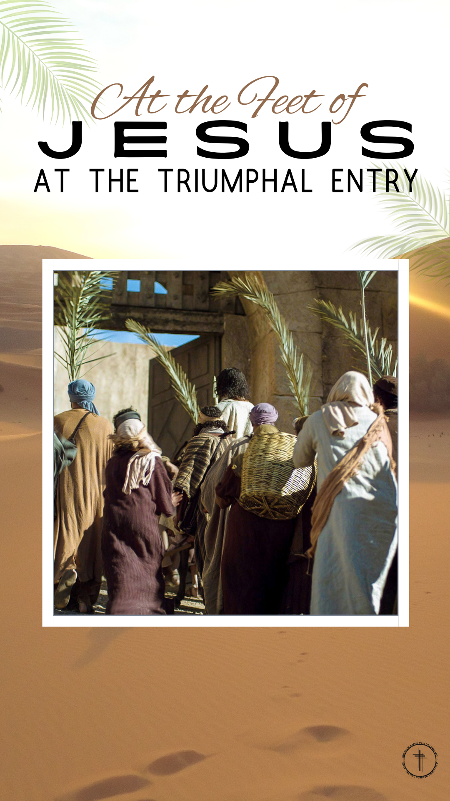
The ___________within the Lord’s Heart
Luke 19:41-44 - And when he drew near and saw the city, he wept over it, ⁴² saying, “Would that you, even you, had known on this day the things that make for peace! But now they are hidden from your eyes. ⁴³ For the days will come upon you, when your enemies will set up a barricade around you and surround you and hem you in on every side ⁴⁴ and tear you down to the ground, you and your children within you. And they will not leave one stone upon another in you, because you did not know the time of your visitation.”
The _______________ for the Lord’s House
Luke 19:45–48 - And he entered the temple and began to drive out those who sold, ⁴⁶ saying to them, “It is written, ‘My house shall be a house of prayer,’ but you have made it a den of robbers.” ⁴⁷ And he was teaching daily in the temple. The chief priests and the scribes and the principal men of the people were seeking to destroy him, ⁴⁸ but they did not find anything they could do, for all the people were hanging on his words.
“Faith that Works with reference to Self-Will”- James 4:1-6, 11-17
Presented by
Pastor Dave Watson
at Calvary Chapel
Presented by Pastor Dave Watson
At Calvary Chapel
Presented By: Pastor Dave Watson

